Slide 1
PIPES
20PW13 & 20PW39

Slide 2
The term pipes refers to the connection of a data flow from one process to another
We attach the output of one process to the input of another.
The pipe symbol is used to connect two commands in shell scripting.
Cmd 1 | cmd 2
Eg : ls|wc
Eg : who|sort

Slide 3
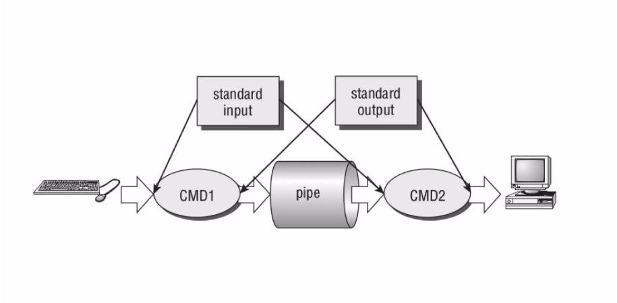
How do pipes work ?

Slide 4
The pipe system call
The lower level pipe function provides a means of passing data between two programs, without the overhead of a shell script to interpret the requested command.
The pipe has the following prototype:
#include<unistd.h>
int pipe(int fd[2]); //where fd is the file descriptor
The pipe is passed an array of two integer file descriptors.
It fills the array with two new file descriptors and returns a 0.
It returns a -1 on failure.

Slide 5
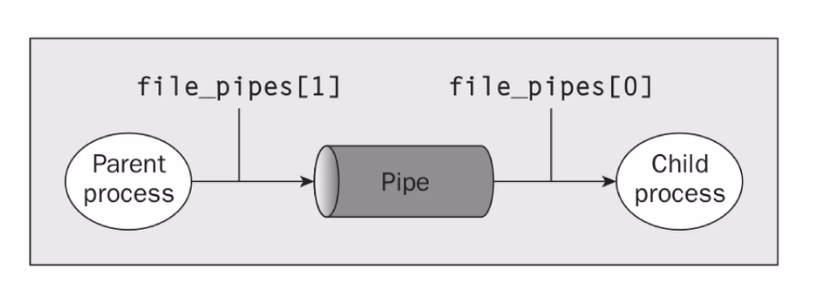
Any data written into fd[1] can be read from fd[0].
The data is processed in a FIFO basis.

Slide 6
The write system call
#include<unistd.h>
size_t write(int fd, const void *buf, size_t nbytes);
It arranges for the first n bytes from the buf to be written to the file associated with the file descriptor fd.
It returns the number of bytes actually written.
This may be less than nbytes if there had been an error in the fd.
If it returns 0 , then no data is written.
-1 indicates an error.

Slide 7
The read system call
Syntax : size_t read(int fd,void *buf,size_t nbytes);
It reads upto n bytes of data from the file associated with fd and places them in the data area buf.
It returns the number of bytes actually read.
If a read call returns 0, it has nothing to read.
If it returns a -1, it means there is an error.

Slide 8
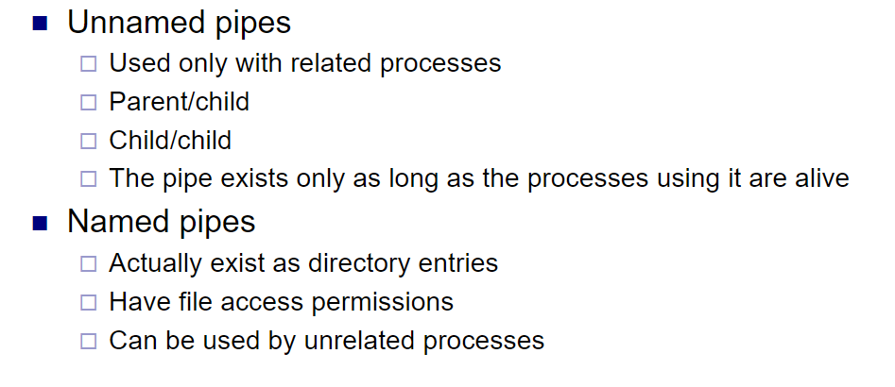
Types of Pipes

Slide 9
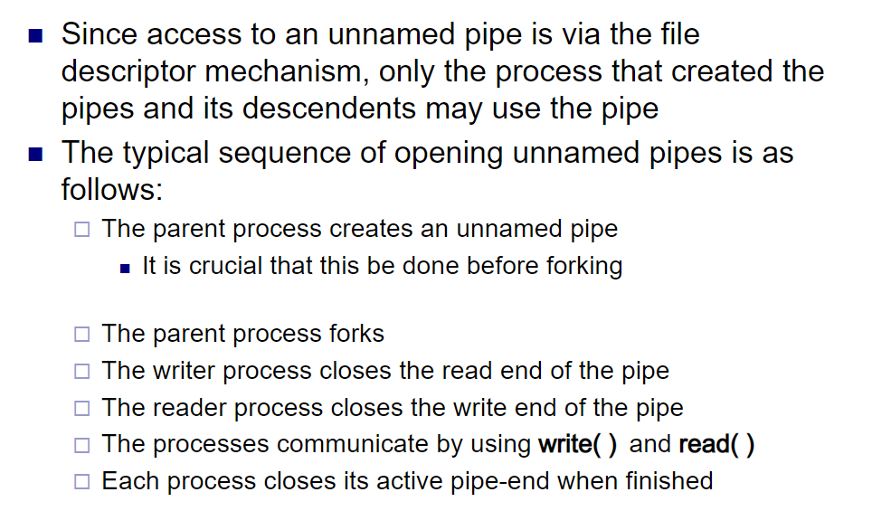
Unnamed Pipes

Slide 10
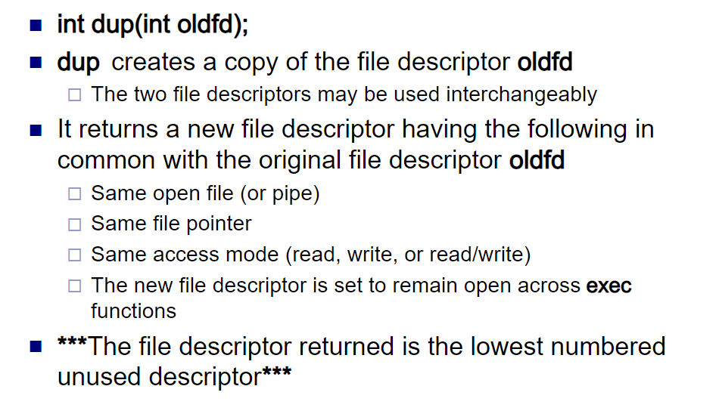
Dup() system call

Slide 11
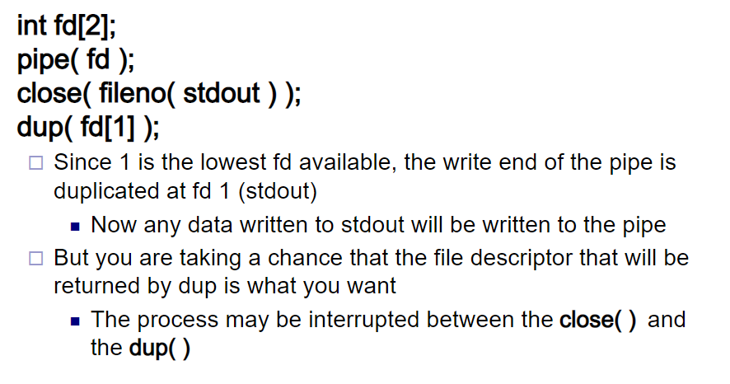

Slide 12
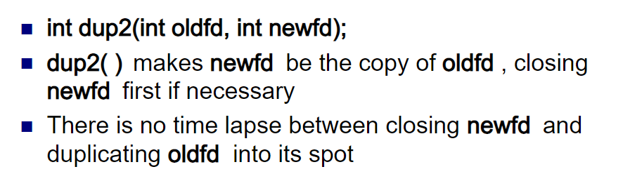
dup2()

Slide 13
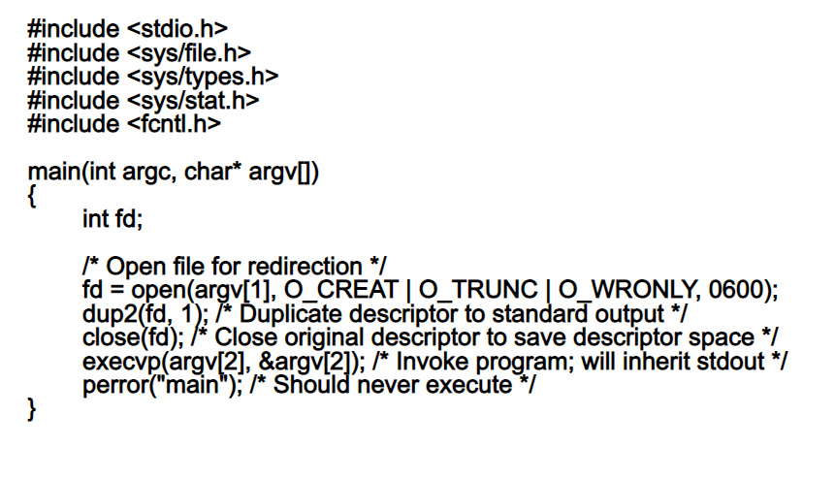

Slide 14
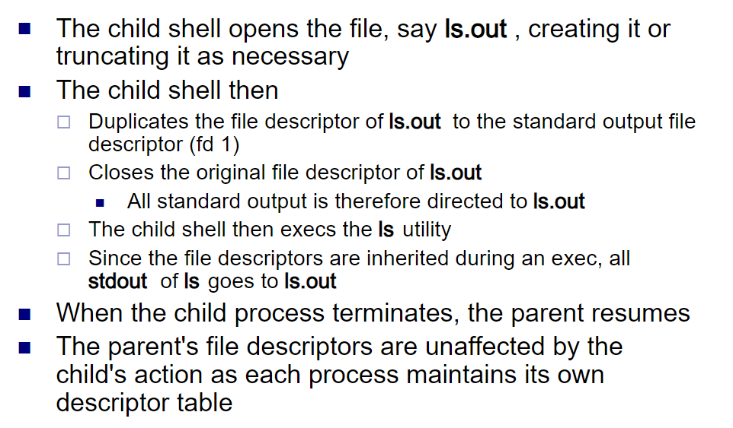
Implementing Redirection

Slide 15
